Slide 1
Face Detection
MINI PROJECT: 2020-2021
TEAM: AMIT GUPTA ANUBHAV BAJPAI
CS- 2-A , PSIT KANPUR
ROUND 2……..

Slide 2
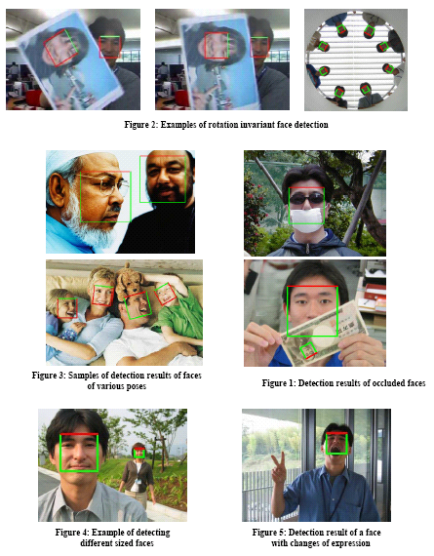
Face Detection: A Solved Problem?
Recent results have demonstrated excellent results
fast, accurate, partial occlusion.
So, is face detection a solved problem?
No, not quite…

Slide 3
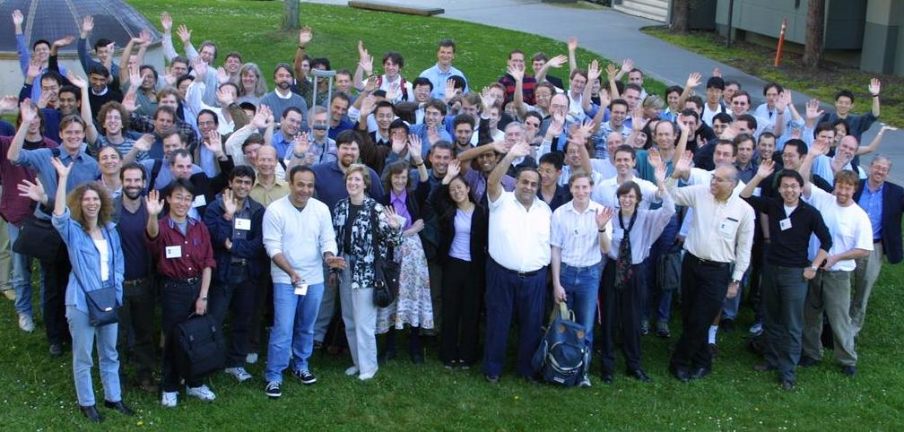
Face Detection
Identify and locate human faces in an image regardless of their
position
scale
in-plane rotation
orientation
pose (out-of-plane rotation)
and illumination

Slide 4
Why Face Detection is Important?
To detect faces in an image or video, regardless of head pose, lighting conditions, and skin color.
For any fully automatic face recognition system
In many surveillance systems
Lots of applications
A step towards Automatic Target Recognition (ATR) or generic object detection/recognition.

Slide 5

In One Thumbnail Face Image
Consider a thumbnail 19 × 19 face pattern
256³⁶¹ possible combination of gray values
256³⁶¹= 2^{8×361} = 2²⁸⁸⁸
Total world population (as of 2004)
6,400,000,000 ≅ 2³²
2⁹⁰ times more than the world population!
Extremely high dimensional space!

Slide 6
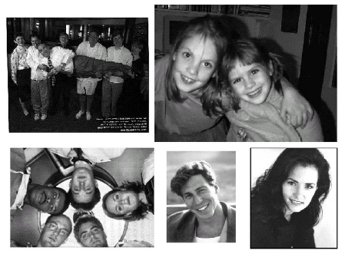
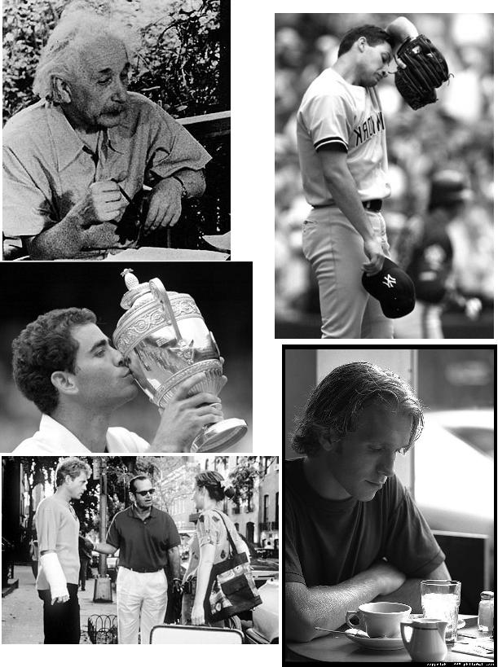
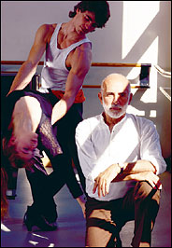
Why Is Face Detection Difficult?
Pose (Out-of-Plane Rotation): frontal, 45 degree, profile, upside down
Presence or absence of structural components: beards, mustaches, and glasses
Facial expression: face appearance is directly affected by a person's facial expression
Occlusion: faces may be partially occluded by other objects
Orientation (In-Plane Rotation): face appearance directly vary for different rotations about the camera's optical axis
Imaging conditions: lighting (spectra, source distribution and intensity) and camera characteristics (sensor response, gain control, lenses), resolution

Slide 7
Face Detector: Ingredients
Target application domain: single image, video
Representation: holistic feature, etc
Pre processing: histogram equalization, etc
Cues: color, motion, depth, voice, etc
Search strategy: exhaustive, greedy, focus of attention, etc
Classifier design: ensemble, cascade
Post processing: combing detection results.

Slide 8
Face Detection: An Approach
Face Detection
Video
Color
Gray Scale
Single Image
Color
Gray Scale
Upright frontal
Pose
Rotation
Occlusion
Focus on detecting
upright, frontal faces
in a single gray-scale image with decent resolution
under good lighting conditions

Slide 9
Agenda
Detecting faces in gray scale images
Detecting faces in color images
Detecting faces in video
Performance evaluation
Research direction and concluding remarks

Slide 10
Knowledge-based Methods: Summary
Pros:
Easy to come up with simple rules to describe the features of a face and their relationships
Based on the coded rules, facial features in an input image are extracted first, and face candidates are identified
Work well for face localization in uncluttered background
Cons:
Difficult to translate human knowledge into rules precisely: detailed rules fail to detect faces and general rules may find many false positives
Difficult to extend this approach to detect faces in different poses: implausible to enumerate all the possible cases

Slide 11
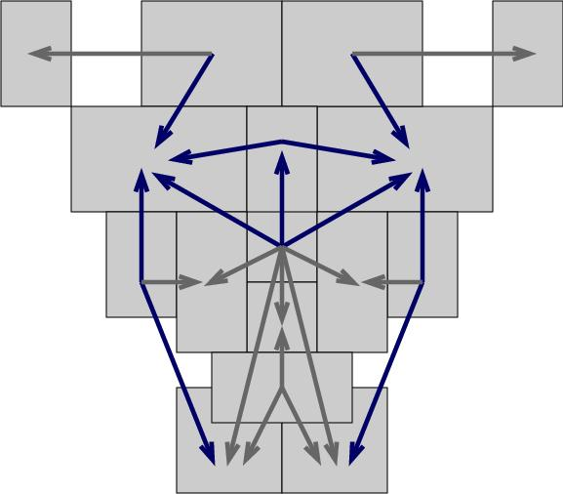

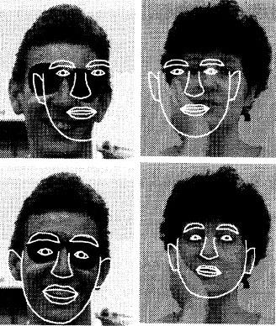
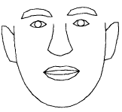
Face Template
Use relative pair-wise ratios of the brightness of facial regions (14 × 16 pixels): the eyes are usually darker than the surrounding face
Use average area intensity values than absolute pixel values
See also Point Distribution Model (PDM).
Ration template
Average shape

Slide 12
Representation
Holistic: Each image is raster scanned and represented by a vector of intensity values
Block-based: Decompose each face image into a set of overlapping or non-overlapping blocks
At multiple scale
Further processed with vector quantization, Principal Component Analysis, etc.

Slide 13
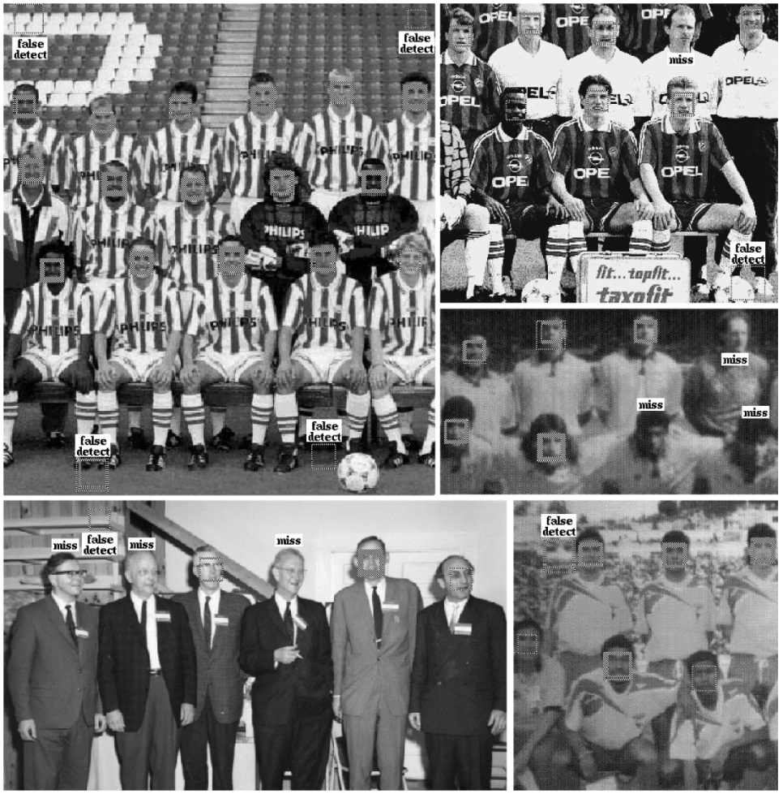
Experimental Results:
Can have multiple detects of a face since it may be detected
at different scale
at a slightly displaced window location
Able to detect upright frontal faces

Slide 14
CODE IMPLEMENTATION

Slide 15


Slide 16


Slide 17


Slide 18
OUTPUT

Slide 19
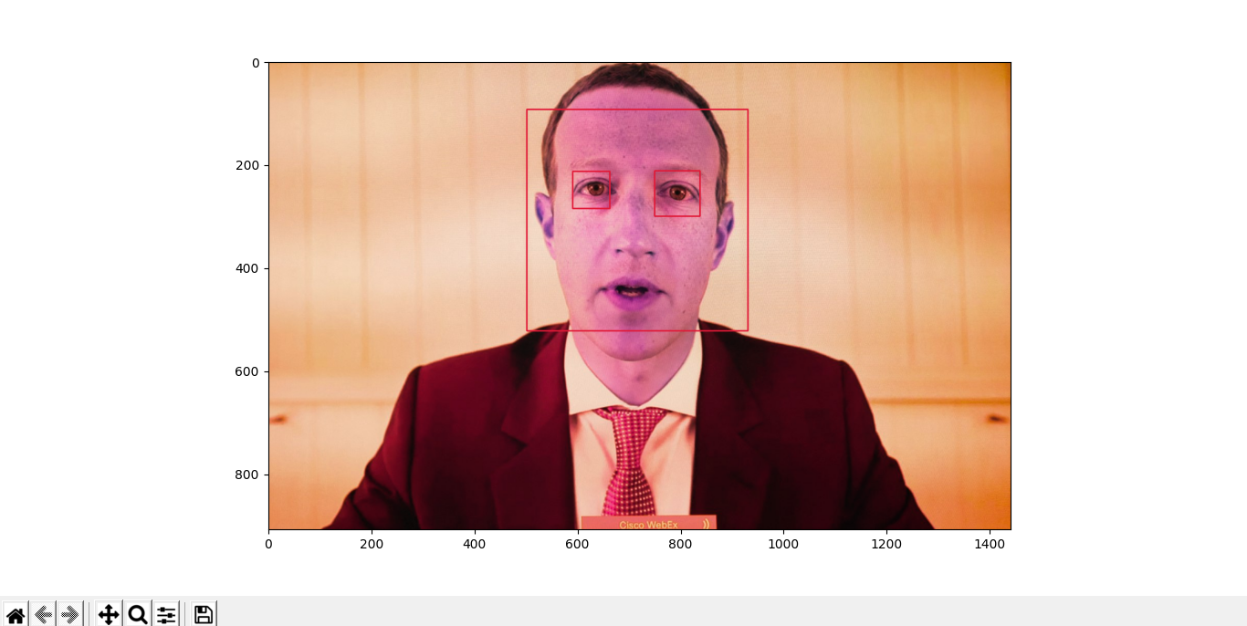

Slide 20
Thank you

